Slide 1




Rockbuster Stealth LLC
Genrong Zhong

Slide 2
Introduction
Objectives
Rockbuster Stealth LLC is a movie rental company that used to have stores around the world. Facing stiff competition from streaming services such as Netflix and Amazon Prime, the Rockbuster Stealth management team is planning to use its existing movie licenses to launch an online video rental service in order to stay competitive.
My job is to use SQL to analyze the data and answer business questions in order to help the company with the launch strategy for the new online video service.

Slide 3
Table of Contents
Questions
Overview
Demographics
Rentals
Recommendations
Questions
Which countries are Rockbuster customers based in?
Do sales figures vary between geographic regions?
Where are customers with a high lifetime value based?
Which genres contributed the most/least to revenue gain?
What was the average rental duration for all videos?
How much was the average monthly spending?

Slide 4
Overview
Count of Film Titles: 1000
Average, Longest, Shortest Rental Duration: 5 Days, 7 Days, 3 Days
Average, Highest and Lowest Rental Rate: $3, $5, $1
Average Rental Revenue per Customer: $102
Total Revenue: $61312
Amount of Language Selections: 6 (English, Italian, Japanese, Mandarin, French, German)

Slide 5
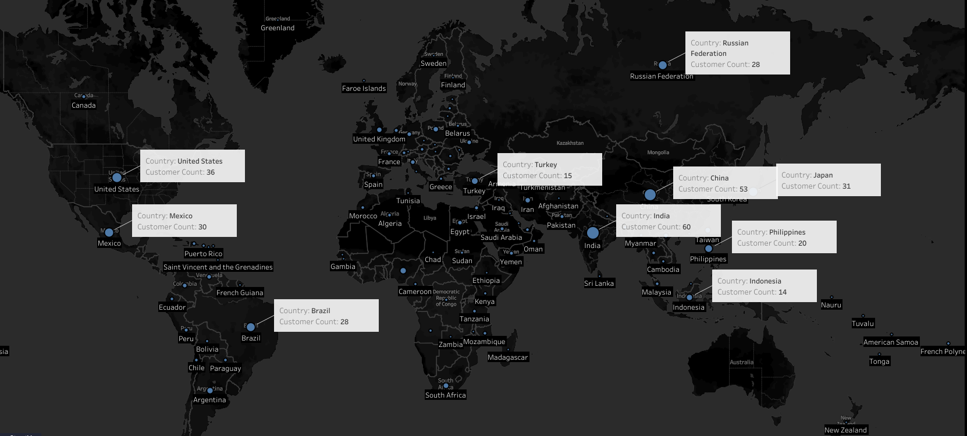
Customer Base World Distribution Map 108 countries, 600 cities, 599 customers (top 10 countries with the highest customer counts are marked).

Slide 6
Top 10 Countries with the Highest Customer Counts
Top 10 countries have 53% of the total customers.

Slide 7
Top 10 Countries with the Highest Revenue
Top 10 Countries generated 52% of the total revenue.

Slide 8
Top 10 Cities with the Highest Revunue
Cities Where Top 10 Customers Are Located
(Most cities have 1 customer except for London and Valparai.)
Since most cities have only 1 customer, every customer’s spending can really affect a city’s performance.
Rockbuster needs to figure out a strategy that can either bring in more customers or encourage customers to spend more consistently.

Slide 9
Title Counts of All Genres and Their Revenue per Title
Drama, sci-fi, comedy, horror and music did really well despite lower title counts. Those genres have true potential if title counts increase.
Foreign, family and documentary did poorly despite high title counts.
Thriller didn’t have a big enough sample size.

Slide 10
Top 10 Monthly Spending and Bottom 10 Monthly Spending
Data Set Time Range: 02/14/2007 – 05/14/2007
Average Customer Monthly Spending is $34.
Could introduce a subscription model to attract new customers, bring in more recurring revenue, and improve customer retention.

Slide 11
Refer to the genres that have potential and the genres that did well in order to build a better movie collection.
Add more titles to the thriller genre to test out the popularity.
Add unique or indie titles that can differentiate Rockbuster.
Send out surveys to gather customers’ preferences.
Movie Collection
Social media or a referral program that can increase the current low customer count.
More languages that cover the top 10 countries.
Marketing
Recommendations
Languages
Pricing
Add a subscription model that charges $17 (50% of customers’ monthly spending).
Send out surveys that gather customers’ opinions on pricing.

Slide 12

Questions?

Slide 13
Thank you!!

